Slide 1



CAPSTONE PROJECT
ADE Guard – Adverse Drug Event Detection System
PRESENTED BY:
STUDENT NAME: Mahida Hemrajsinh P.
COLLEGE NAME: SAL Institute of Technology and Engineering Research
DEPARTMENT: Information and Communication Technology
EMAIL ID: hemrajsinhmahida385@gmail.com

Slide 2
OUTLINE:
Problem Statement
Proposed System/Solution
System Development Approach
Algorithm & Deployment
Result
Conclusion
Future Scope
References

Slide 3
PROBLEM STATEMENT:
The healthcare sector faces critical challenges in medication safety:
Adverse Drug Events (ADEs) cause serious health risks
Drug interactions are often overlooked
Manual prescription checking is error-prone
Lack of real-time alert systems
Increasing patient data complexity

Slide 4
PROPOSED SOLUTION:
ADE Guard is an intelligent system that:
Detects harmful drug interactions
Predicts adverse drug reactions using ML
Provides real-time alerts to doctors
Analyzes patient medical history
Improves decision-making in healthcare

Slide 5
SYSTEM APPROACH:
Machine Learning & Data Processing
Algorithms: Logistic Regression, Decision Tree
Data handling: Pandas, NumPy###
Backend* Python-based system* REST API (optional: Flask/FastAPI)###
Frontend* Simple UI using HTML, CSS###
Database* Patient records + drug dataset (CSV/MySQL).

Slide 6
ALGORITHM & DEPLOYMENT:
Algorithm
1. Input patient data (age, disease, drugs)
2. Preprocess data
3. Apply ML model
4. Predict ADE risk score
5. Generate alert if risk is high###
Deployment* Local system / Web app* Can be deployed using Flask or Django* Optional cloud deployment---

Slide 7
RESULT:
Successfully predicts drug interaction risks
Provides instant alerts
Improves patient safety
Reduces manual effort
👉 Output example:“⚠️ High Risk: Drug A + Drug B may cause severe reaction”

Slide 8
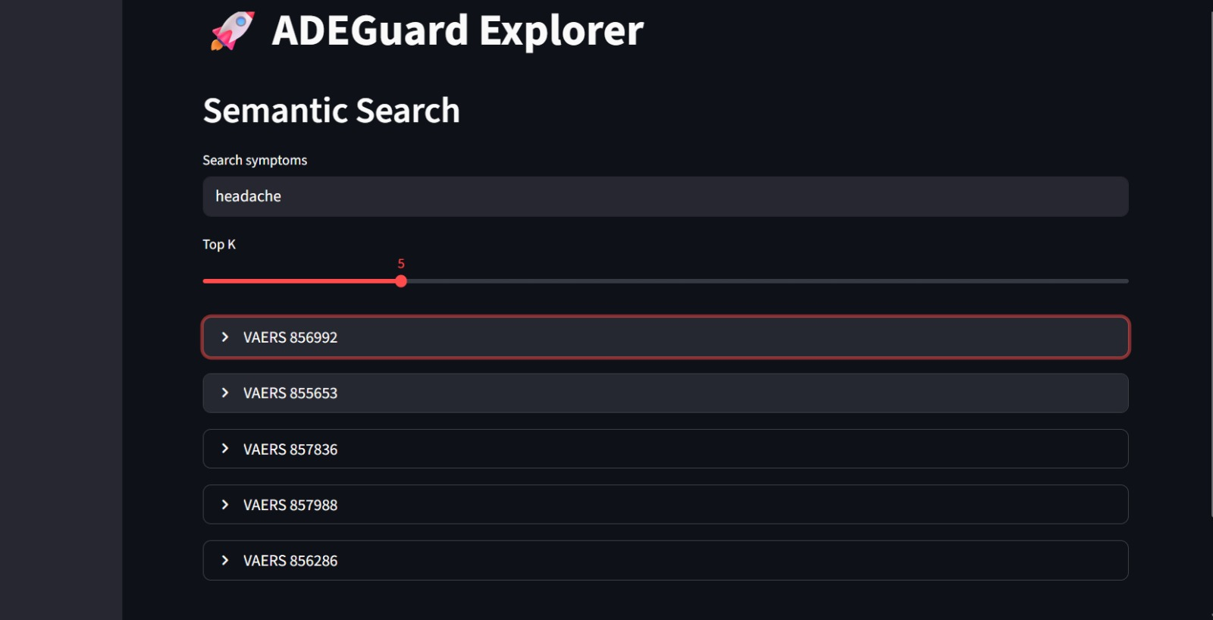

Slide 9
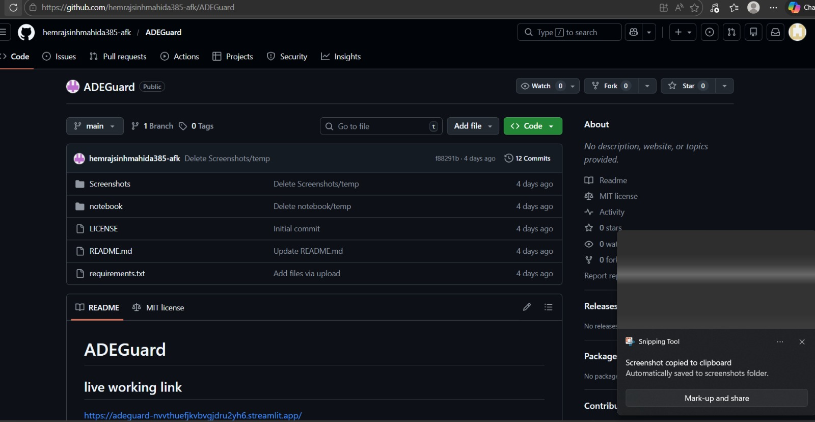

Slide 10
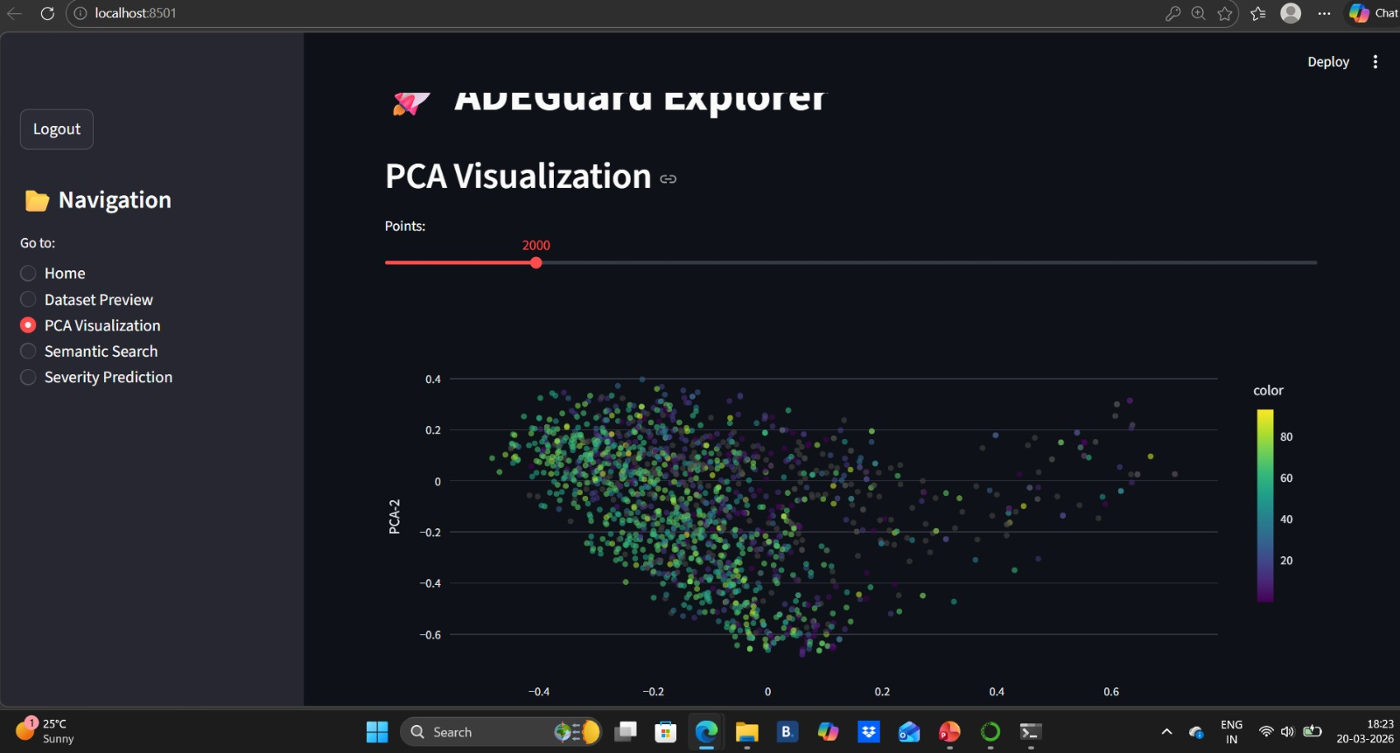

Slide 11
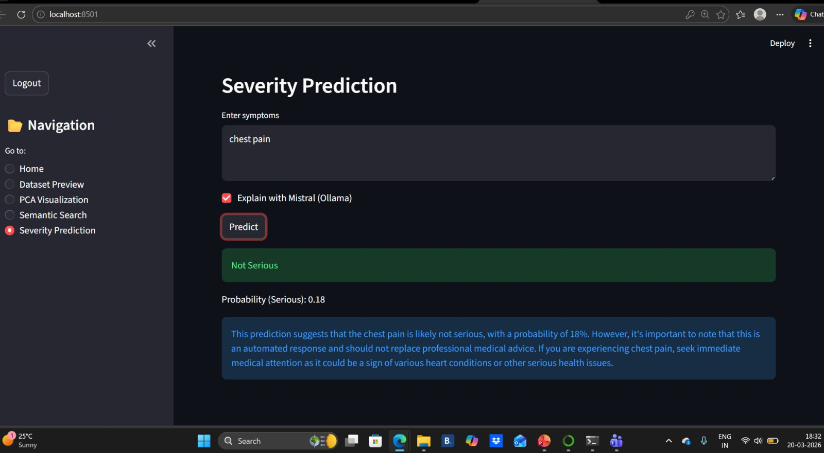

Slide 12
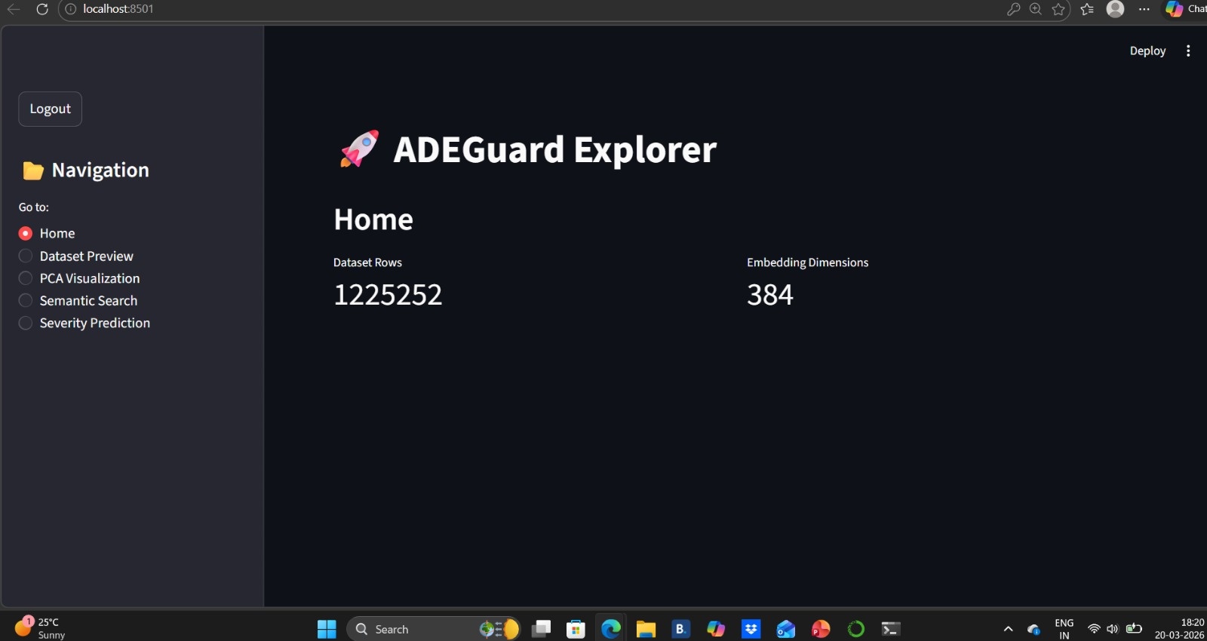

Slide 13
CONCLUSION:
ADE Guard helps in early detection of drug risks
Reduces medical errors significantly
Supports doctors in better decision-making
Makes healthcare systems safer and smarter.

Slide 14
FUTURE SCOPE:
Integration with hospital databases
Use of deep learning for higher accuracy
Mobile app for doctors/pharmacists
Real-time IoT health monitoring
Integration with AI chat assistants---

Slide 15
REFERENCES:
WHO – Adverse Drug Reaction Reports
Scikit-learn Documentation
Research papers on Drug Interaction Prediction* Kaggle Healthcare Datasets
Github link: https://github.com/hemrajsinhmahida385-afk/ADEGuardVAERS
VAERS Dataset: https://share.google/AhkiI8wtN3mqsX3Fo

Slide 16
Thank You

